Slide 1
Course - DT228-2
Module (Subject) -
Human Computer Interaction
Semester 2, Week 7
USER-CENTRED DESIGN

Slide 2
Overview
Life-Cycle Models in Human Computer Interfaces
Four basic activities in HCI
Requrements
Design
Develop/Build
Evaluation

Slide 3
Human Computer Interaction and Design?
Rather than the traditional design models adopted within software engineering, which are characterised by their linearity, Human Computer Interaction has adopted a design model which aspires to incorporate the following premises:
being user centred
being multi disciplinary
being highly iterative

Slide 4
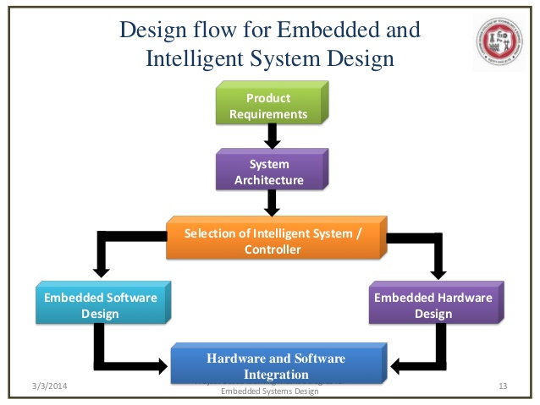
Comparison: System-Centred Design
What can be built on this platform easily?
What can I create using the available tools?
What do I find (as a programmer) interesting to work on?

Slide 5
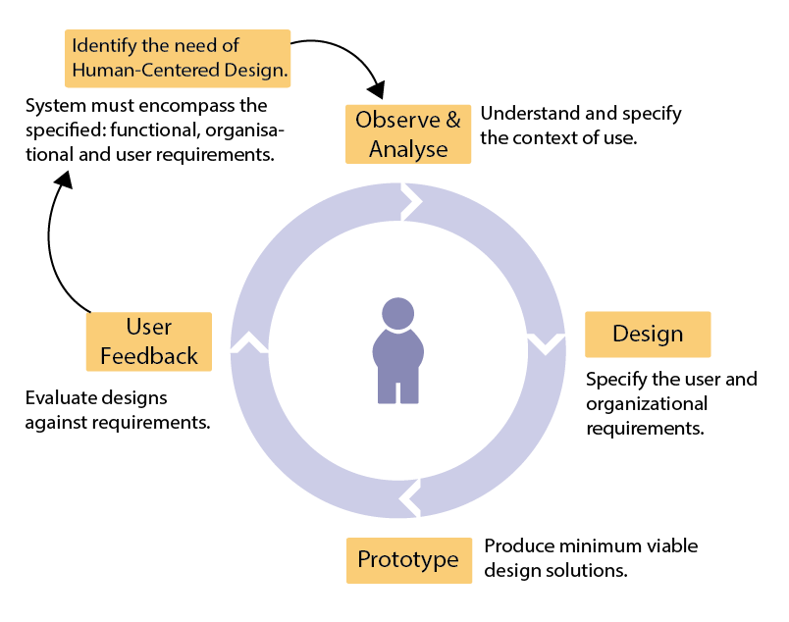
Comparison: User-Centred System Design
A design is based on a user’s:
abilities and real needs
context
work
tasks

Slide 6
What is User-Centred Design?
User Centred Design (USD) is an approach to user interface development and system development.
It focuses on understanding:
the users,
their goals and tasks, and
the environment (physical, organisational, social)
You must pay attention to these throughout development
User-Centred Design

Slide 7
What is User-Centred Design (2)?
It is an approach to interactive system development that focuses specifically on making technical products / web interfaces usable.
The quality of interaction between the person who uses the product to achieve actual work, and the product itself, is the primary goal of user-centred design.
User-centred systems empower users and motivate them to learn and explore new system solutions.
User-Centred Design

Slide 8
Principles of User-Centred Design
Principles of human-centered design processes for interactive systems :
Active involvement of users
Appropriate allocation of function between the user and the system
Iteration of design solutions
Multidisciplinary design teams
User-Centred Design Princilples

Slide 9
Essential Activities in USD
Essential activities in human-centered design:
Understand and specify the context of use
Specify the user requirements, and organisational requirements
Produce design solutions (- prototypes)
Evaluate designs with users against requirements

Slide 10
What is a User-Centred Approach?
A User Centred Approach -
Early focus on users and tasks: directly studying cognitive, behavioural, anthropomorphic and attitudinal characteristics
Empirical measurement: users’ reactions and performance to scenarios, manuals, simulations and prototypes are observed, recorded and analysed
Iterative design: when problems are found in user testing, fix them and carry out more tests
User-Centred Design Approach

Slide 11
Interaction Design – Four Activities
There are four basic activities in Interaction Design:
Identifying needs and establishing requirements
Developing alternative designs
Building interactive versions of the designs
Evaluating designs
Design Activities

Slide 12
Methodology
A user-centred design methodology is characterised by:
the involvement of users throughout the design process
the use of an iterative design cycle
There are a number of ways in which user participation can be facilitated throughout the design process:
focus groups, questionnaires and interviews, observation,
user testing, and many more…

Slide 13
Iterative Design Cycle
Iterative design is a process where an interface is progressively developed and improved over a series of iterations, each the result of user testing and feedback.
In its simplest form, the iterative design cycle can be said to have three phases: design, test, redesign. These phases operate in a continual cycle - in theory!
In practice iterations are limited by budgetary considerations so that designs are continually evaluated and improved.

Slide 14
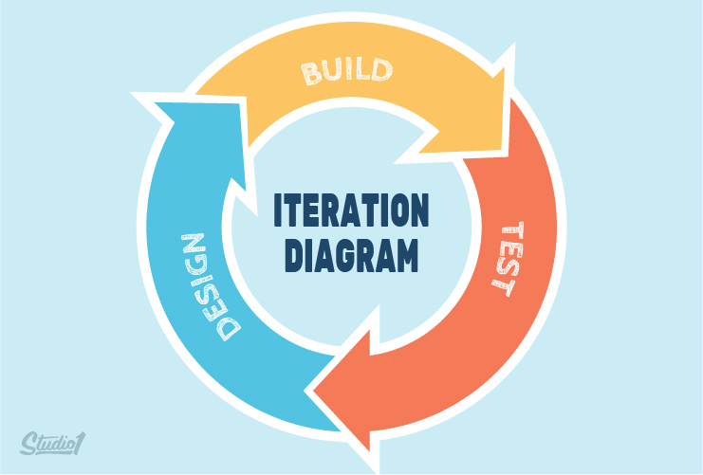
Iterative Design Cycle (2)

Slide 15
Who Are the Users/stakeholders?
Perhaps not as obvious as you think:
those who interact directly with the product
those who manage direct users
those who receive output from the product
those who make the purchasing decision
those who use competitor’s products

Slide 16
Who Are the Users/stakeholders? (2)
There are three categories of user:
primary: frequent hands-on
secondary: occasional or via someone else
tertiary: affected by its introduction, or will influence its purchase

Slide 17
What are the users’ capabilities?
Individual differences. Users’:
size of hands may affect the size and positioning of input buttons
motor abilities may affect the suitability of certain input and output devices
height if designing a physical kiosk
strength - a child’s toy requires little strength to operate, but greater strength to change batteries
disabilities (e.g. sight, hearing, dexterity)
abilities also vary according to context

Slide 18
What are the users’ Needs?
Users rarely know what is possible.
Users cannot tell you what they ‘need’ to help them achieve their goals.
Instead, an analyst can look at existing tasks:
their context
what information do they require?
who collaborates to achieve the task?
why is the task achieved the way it is?

Slide 19
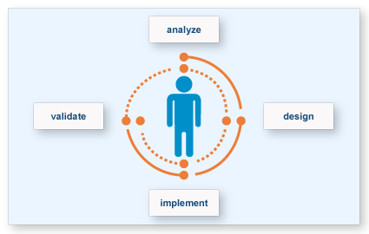
The Golden Rule
The golden rule of interface design: know the user

Slide 20

Task Analysis
Proposed tasks for a new system (or interface):
can be rooted in existing behaviour
can be described as future scenarios

Slide 21
Allocation of Functions
An appropriate allocation of function between user and system:
Determining which aspects of a task should be handled by people and which can be handled by software / hardware is of critical importance. (Task Allocation)
The allocation of function should be based on an appreciation of human capabilities, and their limitations.
This allocation benefits from the input of end-users which will also help to ensure that the results are acceptable to the people who will be affected.

Slide 22
Allocation of Functions (2)
The active involvement of users is the key strength of user-centered design.
Involving end-users can also enhance the acceptance and commitment to the new software as staff some to feel that the system is being designed in consultation with them rather than being imposed upon them.

Slide 23
Iterative Design Uses Prototyping
Iterative design - whereby a prototype is designed, tested and modified is, essentially, an iterative of design solutions.
The users attempt to accomplish ‘real world’ tasks using the prototype, and the feedback from the exercise, is used to develop the design further.

Slide 24
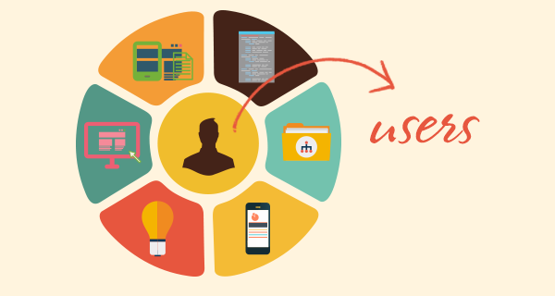
Gathering User Data
A brief overview of common methods to gather user data
Interviews
Questionnaires
Observation
Choosing and combining techniques

Slide 25
Task Analysis - Interviews
Unstructured - are not directed by a script. Rich but not replicable.
Structured - are tightly scripted, a questionnaire delivered verbally. Replicable but may lack richness.
Semi-structured - guided by a script but interesting issues can be explored in more depth. Can provide a good balance between richness and replicability.

Slide 26
Interview Questions
Two types:
‘Closed questions’ have a predetermined answer format. E.G., ‘Yes’ or ‘No’
‘Open questions’ do not have a predetermined format
Closed questions are easier to analyse.

Slide 27
Interview Questions (2)
Avoid:
Long questions
Compound sentences - split them into two
Jargon and language that the interviewee may not understand
Leading questions that make assumptions, E.G., ‘Why do you like…?’
Unconscious biases, E.G., gender stereotypes

Slide 28

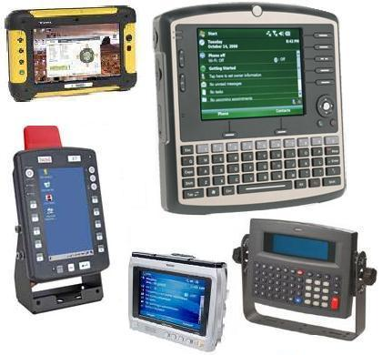
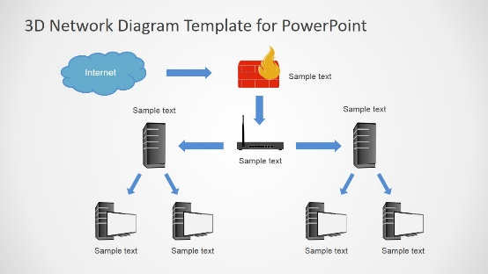
Enriching the interview process
Use props - devices for prompting interviewee – if you feel they will help, E.G., a prototype, scenario, visual, audio…

Slide 29
Contextual Inquiry
An approach to ethnographic study. Contextual inquiry is often conducted as ‘an apprenticeship’ where user is the expert, the analyst/designer is an apprentice.
A form of interview, but
takes place at users’ workplace (workstation)
is around 2 to 3 hours long

Slide 30
Contextual Inquiry (2)
Four main principles:
Context: see the workplace and what happens
Partnership: the user and developer collaborate
Interpretation: observations are interpreted by user and developer together
Focus: get to a project focus to understand what to look for

Slide 31
questionnaire
Questions can be closed or open
Closed questions are easier to analyse, and may be done using a computer, E.G. Online.
Can be administered to large populations.
Paper, email and the web used for dissemination.
Sampling can be a problem when the size of a population is unknown, as is common online.

Slide 32
Questionnaire Design
The impact of a question can be influenced by question order.
Do you need different versions of the questionnaire for different populations?
Provide clear instructions on how to complete the questionnaire.
Strike a balance between using white space and keeping the questionnaire compact.
Decide on whether phrases will all be positive, all negative or mixed.

Slide 33
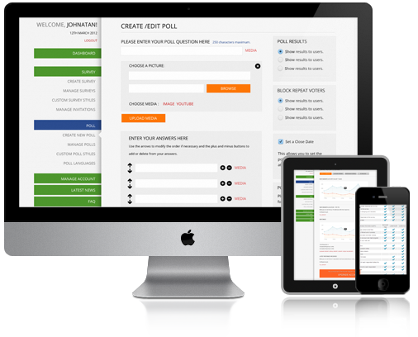
Online questionnaires
Advantages of online questionnaires
Responses are usually received quickly
No copying and postage costs
Data can be collected in a database for analysis
Time required for data analysis is reduced
Errors can be corrected easily

Slide 34
Online questionnaires (2)
Problems with online questionnaires
Sampling is problematic if population size is unknown
Preventing individuals from responding more than once
Individuals have also been known to change questions in email questionnaires

Slide 35

Observation
Direct observation in the field
Structuring frameworks
Degree of participation (insider or outsider)
Ethnography
Direct observation in controlled environments
Indirect observation: tracking users’ activities
Diaries
Interaction logging

Slide 36
Observation (2)
Structuring frameworks to guide observation
The person - Who?
The place - Where?
The thing - What?

Slide 37
Observation (3)
Who is present?
What is their role?
What is happening?
When does the activity occur?
Where is it happening?
Why is it happening?
How is the activity organised?

Slide 38
Observation (4)
Direct observation in a controlled setting
Watching people perform tasks
Consider the ‘Think-Aloud Technique’
Indirect observation – where you read:
Diaries
Interaction logs
Other work-related documents

Slide 39
Ethnography
Ethnography is a philosophy with a set of techniques that include participant observation and interviews
Debate about differences between participant observation and ethnography
Ethnographers immerse themselves in the culture that they study
A researcher’s degree of participation can vary along a scale from ‘outside’ to ‘inside’
Analyzing video and data logs can be time-consuming
Collections of comments, incidents, and artifacts are made.

Slide 40
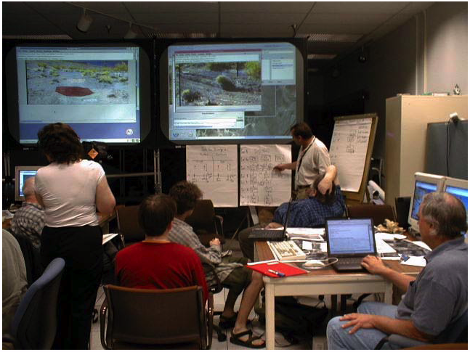
Ethnography (2)
Co-operation of the people being observed is required
Informants are useful
Data analysis is continuous
It is an interpretivist technique
Questions get refined as understanding grows
Reports usually contain examples

Slide 41
Analysis and Design
Choosing and combining techniques depends on:
the focus of the study
the participants involved
the nature of the technique
the resources available

Slide 42
User Centred Design Project Overview
The analyst/designer must understand users’ behaviours and needs in an ‘activity context’.
The designer or group will be assigned an approach:
Surveys (in-person, on-line)
Interviews (structured, semi-structured, unstructured)
Focus groups
Direct observation (in the field, in a more controlled environment)
Indirect observation (diary studies, activity traces)

Slide 43
User Centred Design Project Overview (2)
The designer or group will:
develop specific research questions appropriate to the approach
design a user study
submit an ethics proposal (to allow her/him/them to engage with employees)
pilot during an appropriate time (scheduled)
incorporate feedback into a study design document
synthesise their results from various methods
write up report reflecting on methodological choices and appropriateness of study design for research questions

Slide 44
Multi-disciplinary design teams
User-centered design is a collaborative process which benefits from the active involvement of various parties, each of whom have insights and expertise to share.
Design teams may include managers, usability specialists, training and support staff, software engineers, and of course the end user themselves.

Slide 45
The User-Centered Design Project
Project planning has to allow for iteration and for incorporating user feedback.
More time will also be required for effective communication between design team participants and for reconciling potential conflicts and trade-offs.
However, project managers will benefit from the additionally creativity and ideas from an extended development team and skill base.

Slide 46
The User-Centered Design Project (2)
Users will also feel a strong sense of ownership of the system that results.
Above all, proper consideration of usage issues early on in the project will result in a better design and significant savings at later stages when changes are much more costly.

Slide 47
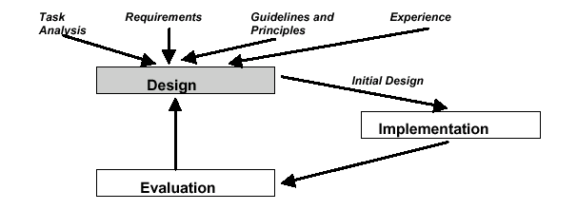
Iterative Design Using Prototyping
Generate a prototype of the design. E.G. initial design from guidelines and principles
Evaluate the design; Redesign to correct any errors; Build new prototype

Slide 48
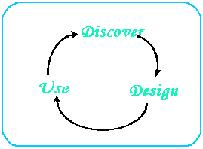
Discover, Design, Use
For designing web interfaces
User-Centered Web Design

Slide 49
Summary of the Lecture
HCI Design Models
Requirements
Design
User-Centred Design
HCI Analysis Methods
Data gathering
HCI Design Considerations

Slide 50
References
Preece, J. et al. (2002) Interaction Design
Shneiderman, B. & Plaisant, C. (2005) Designing the User Interface
Benyon, D. et al (2005) Designing Interactive Systems
Helander, M. et al (1997) Handbook of Human-Computer Interaction
Hartson, R. & Hix, D. (1989) Towards Empirically Derived Methodologies and Tools for HCI Development
Preissle, J., & Le Compte, M. D. (1984). Ethnography and qualitative design in educational research. Academic Press.
Cato, J. (2001) User Centered Web Design
References

